Slide 1

Sauce & Spoon
Tablet Rollout
Impact Report

Slide 2
Executive Summary
The Sauce & Spoon tablet project was initiated to address the need for enhanced customer experience and operational efficiency in our restaurant locations. Through the successful rollout of the tablets, we have achieved significant milestones and added value to our business.
The project's vision was to provide customers with a seamless dining experience while streamlining our internal processes. By implementing the tablets, we have fulfilled this need and improved the overall efficiency of our operations.
Two key accomplishments of the tablet project include increased customer satisfaction and improved revenue growth. The tablets have allowed us to enhance order accuracy, reduce wait times, and provide personalized recommendations to our customers. These improvements have led to higher customer satisfaction ratings and increased repeat visits, resulting in substantial revenue growth.
Activities, tasks, and milestones that contributed to the project's success included comprehensive user training, close collaboration with the technology team, and thorough testing and feedback collection during the pilot phase. By diligently executing these tasks, we ensured a smooth rollout and seamless integration of the tablets into our daily operations.
Two valuable lessons learned from this project are the importance of effective change management and the need for ongoing training and support. To further enhance future rollouts, we recognize the need for proactive communication with staff and customers, as well as continuous training to maximize the utilization and benefits of the tablet system.
Moving forward, our next steps include expanding the tablet rollout to additional Sauce & Spoon locations to leverage the success achieved thus far. We will also focus on continuous improvement by actively seeking feedback from customers and staff to identify areas for refinement and optimization. Additionally, we will explore integrating new features and functionalities into the tablet system to enhance the dining experience and drive further growth.

Slide 3
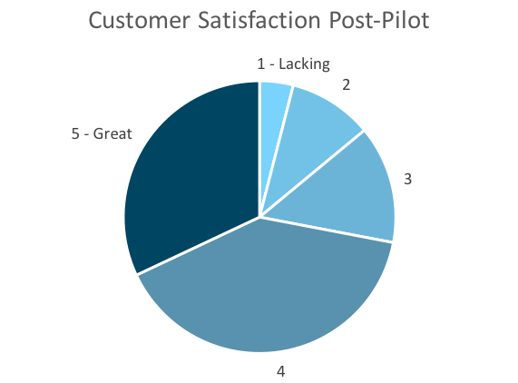
Customer Satisfaction: Pilot
Q. On a scale of 1-5, please rate your experience with the tablet overall.
This pie chart illustrates the results from the post-pilot survey.
72% of respondents indicated a customer satisfaction score of 4 or 5.
Notes:
First pie chart: Results from the post-pilot survey
Second pie chart: Results from the post-launch survey, after making changes
Satisfaction has gone up from 72% (4 and 5 rating) to 86% (4 and 5 rating)
Post-pilot data:
1 - Lacking 2 4%
2 5 10%
3 7 14%
4 20 40%
5 - Great 16 32%
Post-launch data:
1 - Lacking 1 2%
2 2 4%
3 4 8%
4 22 44%
5 - Great 21 42%

Slide 4
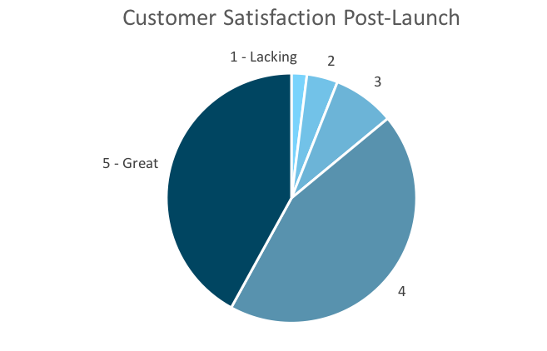
Customer Satisfaction: Launch
Q. On a scale of 1-5, please rate your experience with the tablet overall.
This pie chart illustrates the results from the post-launch survey.
86% of respondents indicated a customer satisfaction score of 4 or 5. This is a 14% increase.
Notes:
First pie chart: Results from the post-pilot survey
Second pie chart: Results from the post-launch survey, after making changes
Satisfaction has gone up from 72% (4 and 5 rating) to 86% (4 and 5 rating)
Post-pilot data:
1 - Lacking 2 4%
2 5 10%
3 7 14%
4 20 40%
5 - Great 16 32%
Post-launch data:
1 - Lacking 1 2%
2 2 4%
3 4 8%
4 22 44%
5 - Great 21 42%

Slide 5
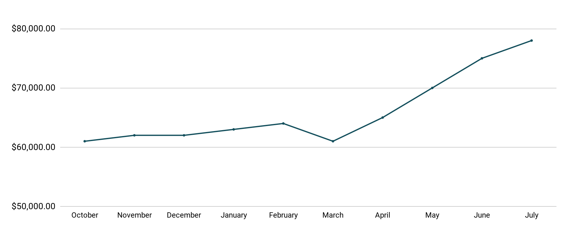
Revenue
Tablet Launch April 23
This is a chart of Sauce & Spoon revenue, showing that after tablet implementation, revenue increased.
July revenue was up to 20% over April’s monthly revenue.
Notes:
This is a chart of Sauce & Spoon revenue, showing that after tablet implementation, revenue increased. December revenue was up to 20% over September’s monthly revenue.
Sales data:
October
$61,000.00
November
$62,000.00
December
$62,000.00
January
$63,000.00
February
$64,000.00
March
$61,000.00
April
$65,000.00
May
$70,000.00
June
$75,000.00
July
$78,000.00

Slide 6
What Worked: Key Accomplishments
Decreased table turn time
Implementation of the tablets increased the average daily guest count by 10%.
Tablets also decreased wait time by 30 minutes.
Decreased food waste
Tablets identified who was receiving an incorrect order.
Kitchen staff has taken the initiative to correct orders and decrease food waste by 50%.
Increased customer satisfaction
After the pilot, customer satisfaction was at 72%.
Once we implemented improvements based on feedback, customer satisfaction increased to 86%.
Increased sales
Our monthly revenue has increased steadily since the tablet rollout, upwards of 20% since September/pre-rollout.
Tablets also helped boost revenue during the holiday season.

Slide 7
Next Steps: Looking Forward
Initiative | Action | Date
Implement tablets in more locations | Create new project plan for new location installation | Q2
Continue to track customer experience and satisfaction | Continue surveying/ gathering data through various means | Ongoing
Expand tablet features | Investigate new features like social media integration, reservations, videos, etc. | Q4

Slide 8
Appendix
Access all resources here.
Notes:
Insert link to your shared drive or a shared folder with all of the relevant project artifacts

